Slide 1
Surplus-Production Models
Pranaya Kumar Parida
Fisheries Scientist, CRFM

Slide 2
What is surplus production model?
Biomass
Growth
(G)
Recruitment
(R)
Natural mortality (M)
+
Catch
+
Present Biomass = (previous biomass+ growth+ recruitment) -
(Natural mortality during the period + Fish catch)
In terms of Numbers
Present Biomass (in nos) = {previous biomass (nos)+ recruitment (nos) } -
{Natural mortality during the period (nos) + Fish catch (nos)}
New biomass = last biomass + surplus production -catch

Slide 3
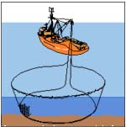
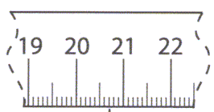
B_{t+1}=B_{t}+R+G-M-C
Death
(Natural mortality)
Recruitment
(+)
Whole population
(-)
Catch
(Fishing mortality)
(-)
Growth
(+)
Surplus production = (Growth+ Recruitment)- (natural mortality)

Slide 4
Why to use surplus production model
Lesser inputs required than the Analytical Model
Assume that all fishery resources are homogenous
Length class or age class of target species can be ignored
Needed only catch and effort data
In case of data are limited, the Holistic Model can be used
Most suitable for data-limited situation
The objective of surplus production model was to estimate the optimum fishing effort and Maximum sustainable yield (MSY)

Slide 5
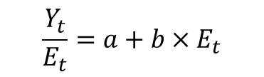
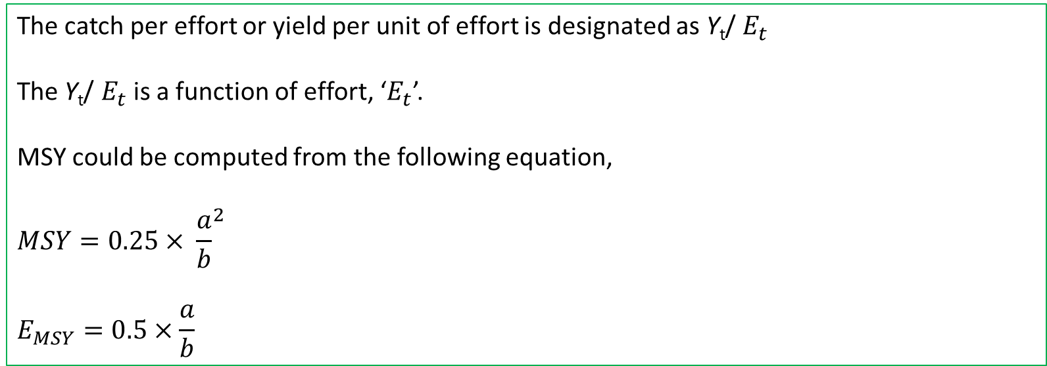

Functional forms of surplus productions
Schaefer (logistic) model:
r= intrinsic growth rate
B = Biomass of fish stock
K = carrying capacity
$$\frac{ⅆB_{t}}{ⅆt}=rB_{t}\left(1−\frac{B_{t}}{k}\right)$$
The catch per effort or yield per unit of effort is designated as Y_{t}/ $E_{t}$
The Y_{t}/ $E_{t}$is a function of effort, ‘$E_{t}$’.
MSY could be computed from the following equation,
$$MSY={0.25× \frac{a}{b}}^{2}$$
$$E_{MSY}=0.5×\frac{a}{b}$$
$$\frac{Y_{t}}{E_{t}}=a+b×E_{t}$$

Slide 6
General form of surplus production
Bt+1 = Bt + Rt + Gt - Mt – Ct
Bt+1 = Bt + Pt – Ct
Bt+1 = Bt + f(Bt) – Ct
Bt+1: Biomass in the beginning of year t+1 (or end of t)
Bt: Biomass in the beginning of year t
Pt: Surplus production
  - the difference between production (recruitment + growth) and natural mortality
f(Bt): Surplus production as a function of biomass in the time period of t
Ct: Biomass (yield) caught during year t

Slide 7
Logistic population growth
Unharvested curve

Slide 8
Surplus production as a function of stock size
Maximum production
K
K /2

Slide 9

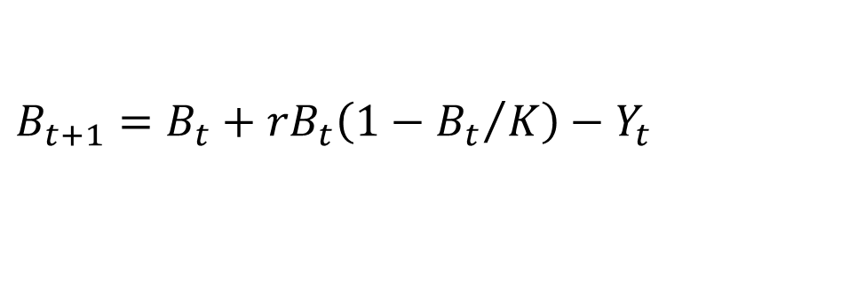
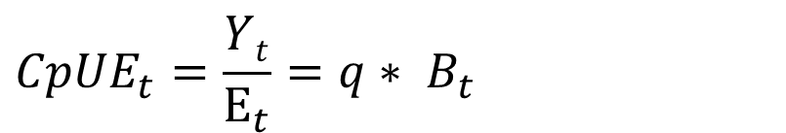
In fishery exploited system
$$B_{t+1}=B_{t}+rB_{t}\left(1−{B_{t}}/K\right)−Y_{t}$$
$$Y_{t}=F_{t}B_{t}=qE_{t}B_{t}$$
Where, r = intrinsic growth rate
B = biomass at time t
q = catchability co-efficient
K = Carrying capacity
Y = total catch
F = fishing mortality
E = fishing effort
$${CpUE}_{t} depedends on the the biomass at time t$$
$${CpUE}_{t}=\frac{Yt}{E_{t}}=q∗ B_{t}$$
index of abundance

Slide 10
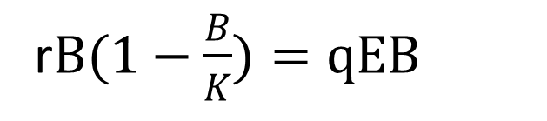
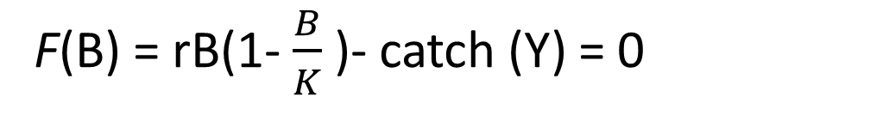
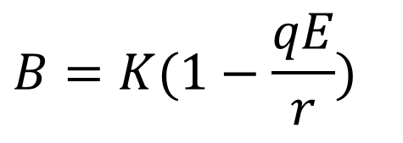
Steady state fish stock
F(B) = rB(1- $\frac{B}{K}$ )- catch (Y) = 0
F(B) = yield or catch = qEB
Where q= catchability coefficient
E = fishing effort
r$B(1−\frac{B}{K})=qEB$
$$B=K(1−\frac{qE}{r})$$
Notes:
Graafisesti!

Slide 11
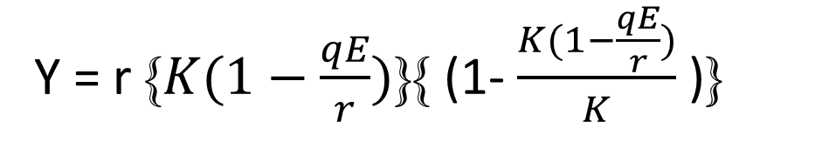
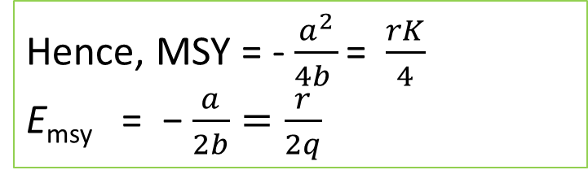
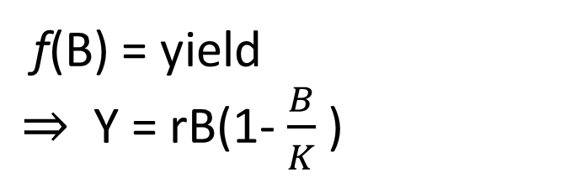
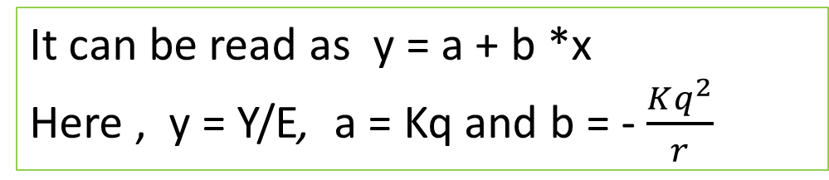
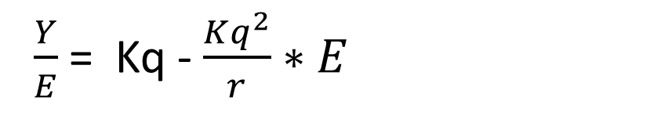
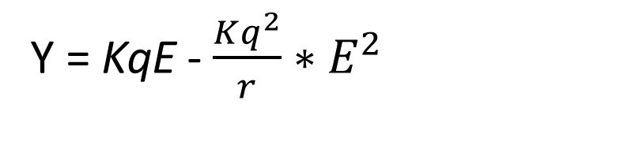
Using the B value from the last equation in
f(B) = yield
$⇒$ Y = rB(1- $\frac{B}{K}$ )
Y = r {$K(1−\frac{qE}{r})\text{\}}${ (1- $\frac{K(1−\frac{qE}{r})}{K}$ )}
Y = KqE - $\frac{Kq^{2}}{r}∗E^{2}$
Equation of Parabola
$\frac{Y}{E}$= Kq - $\frac{Kq^{2}}{r}∗E$
Catch per unit effort
It can be read as y = a + b *x
Here , y = Y/E, a = Kq and b = - $\frac{Kq^{2}}{r}$
Hence, MSY = - $\frac{a^{2}}{4b }\text{=}$ $\frac{rK}{4}$
E_{msy} = $\text{ −}$ $\frac{a}{2b}=\frac{r}{2q}$
Similar, to maxima of Parabola

Slide 12
The reference points from a production model
Biomass giving maximum sustainable yield:
B_{MSY} = K/2
Fishing mortality rate leading to B_{MSY}:
F_{MSY} = r/2
Effort leading to B_{MSY} :
    E_{MSY} = F_{MSY}/q = (r/2)/q = r/(2q)
Maximum sustainable yield
    MSY = F_{MSY} * B_{MSY} = r/2 * K/2 = rK/4

Slide 13
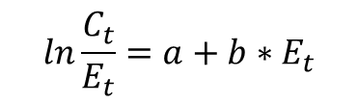
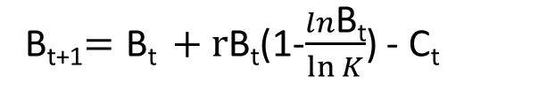
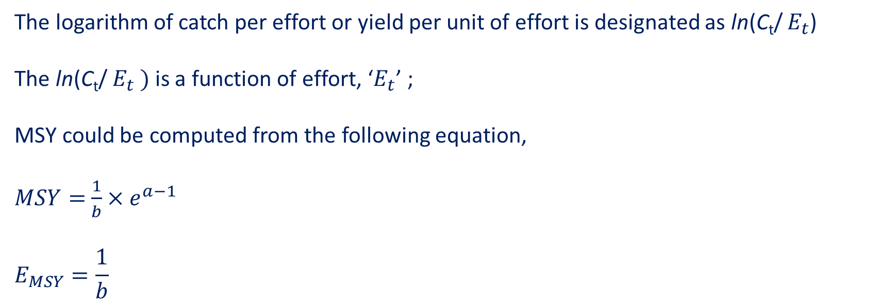
Fox model
B_{t+1}$=\text{B}\text{t} +\text{r}\text{B}\text{t}$(1-$\frac{ln\text{B}\text{t}}{\ln{K}}$) - $\text{C}\text{t}$
The logarithm of catch per effort or yield per unit of effort is designated as ln(C_{t}/ $E_{t}$)
The ln(C_{t}/ $E_{t} )$is a function of effort, ‘$E_{t}$’ ;
MSY could be computed from the following equation,
$MSY=$ $\frac{1}{b}×e^{a−1}$
$$E_{MSY}=\frac{1}{b}$$
$$ln\frac{C_{t}}{E_{t}}=a+b∗E_{t}$$

Slide 14
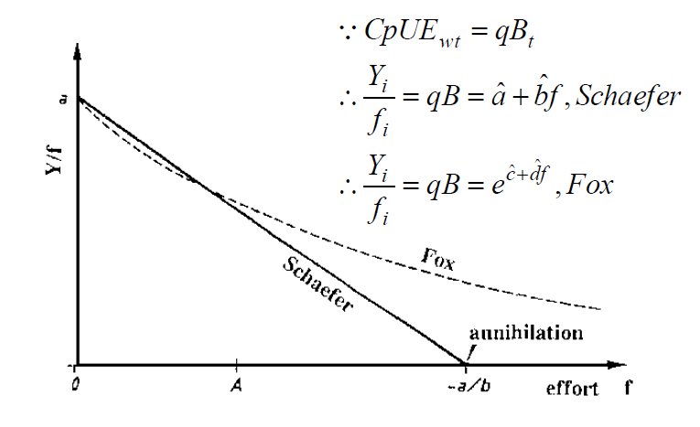
Comparison of Schaefer and fox model

Slide 15
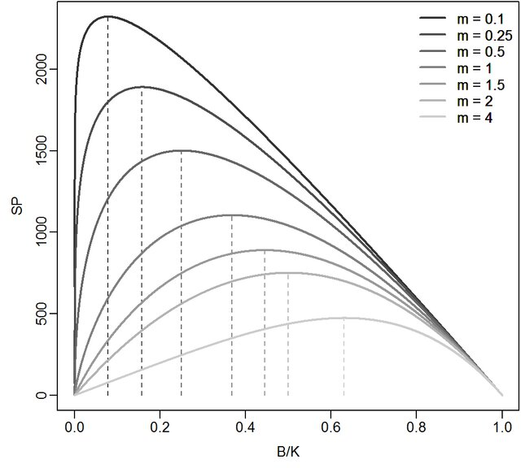
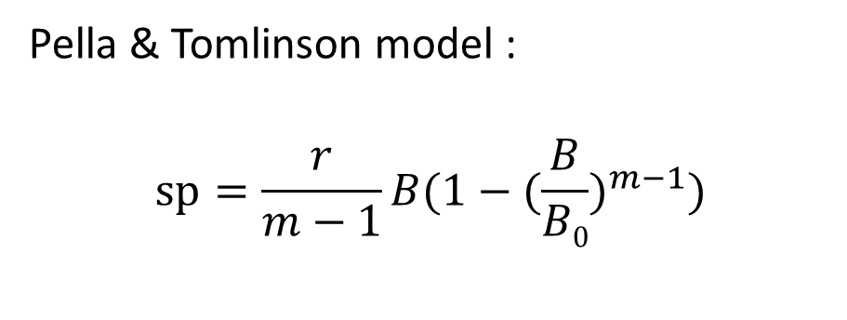
Pella & Tomlinson model
Generalized production model
Pella & Tomlinson model :
$$sp=\frac{r}{m−1}B(1−({\frac{B}{B0})}^{m−1})$$
where r is the intrinsic rate of population increase, B₀ is the unfished biomass and m is a shape parameter that determines at which B/ B₀ ratio maximum surplus production is attained. If the shape parameter m = 2, the model reduces to the Schaefer form, with the surplus production (SP) attaining MSY at exactly B₀/2. If 0 < m < 2, SP attains MSY at biomass levels smaller than K/2; the converse applies for values of m greater than 2. The Pella-Tomlinson model reduces to a Fox model (Fox, 1970) if m approaches one.
This model adds an additional parameter to the logistic equation that allows various shapes in the production function, and does not require the equilibrium assumption.

Slide 16
Disadvantage of surplus production model
Does not incorporate environmental factors
Excludes trophic linkages
Assumes stock has stabilized at current rate of fishing
Doesn’t tell us much about the mechanisms affecting the population dynamics

Slide 17
Exercise - dummy data
Biomass (start) | surplus production | catch
1000.00 | 200.00 | 250
Expecting 20% as the surplus production of biomass

Slide 18
Example - dummy data
Biomass (start) | surplus production | catch | biomass(end)
1000.00 | 200.00 | 250 | 950.00
950.00 | 190.00 | 250 | 890.00
890.00 | 178.00 | 250 | 818.00
818.00 | 163.60 | 250 | 731.60
731.60 | 146.32 | 250 | 627.92
627.92 | 125.58 | 250 | 503.50
503.50 | 100.70 | 250 | 354.20
354.20 | 70.84 | 250 | 175.05
175.05 | 35.01 | 250 | -39.95
Expecting 20% as the surplus production of biomass

Slide 19
State- Space model
State-space models consist of a process model for unobserved quantities (e.g. true stock abundances) and an observation model for observed quantities (e.g. catches or survey data).
SSMs consist of two time-series, and gives the flexibility to formulate models where time-varying quantities follow e.g. a random walk or an autoregressive (AR) process
Standard statistical assessment models do not include stochastic population processes. Prediction is a natural part of the state-space model formulation which is a more practical advantage of the approach for stock assessment.
Quantity of Interest
Time
Ref: ICES (2020). Workshop on the Review and Future of State Space Stock Assessment Models in ICES (WKRFSAM). ICES Scientific Reports. Report. https://doi.org/10.17895/ices.pub.6004

Slide 20
Bayesian model
Bayesian statistics is a theory based on the Bayesian interpretation of probability where probability expresses a degree of belief in an event. The degree of belief may be based on prior knowledge about the event, such as the results of previous experiments, or on personal beliefs about the event. This differs from a number of other interpretations of probability, such as the frequentist interpretation that views probability as the limit of the relative frequency of an event after many trials.
Use Bayes' theorem to compute and update probabilities after obtaining new data. Bayes' theorem describes the conditional probability of an event based on data as well as prior information or beliefs about the event or conditions related to the event

Slide 21
The importance of biology
Age to maturity: 1 year (Fish A), 2 years (Fish B)
Fishing Mortality: 2 per year (both)
Natural Mortality: 0 per year (both)
Recruitment: half spawners per year (both)
Growth: 0 per year (both)
Fish A
1 years
2 years
3 years
4 years
5 years
Fish B

Slide 22
Accuracy = Precision + Bias
References
Winker, H., Carvalho, F., Kapur, M., 2018a. JABBA: Just Another Bayesian Biomass Assessment. Fish. Res. 204, 275–288.
https://fishvice.hafro.is/lib/exe/fetch.php/crfm:04surplusproductionmodel.ppt
https://oceanfish.spc.int/en/ofpsection/ema/biopelagos/lettres-dinformation/doc_details/474-03-fish-population-abd-fished-population-dynamics
http://www.seafdec.or.th/neritic-tunas/documents/Training%20Material/Stock%20Assessment%20Basic%20Level%202/11-MSY.pdf
http://people.uncw.edu/scharff/courses/458/Lecture%2011%20-%20surplus%20production%20models.pdf
Not accurate and not precise
Accurate but not precise
(Vaguely right)
Precise but not accurate
(Precisely wrong)
Accurate and precise
It is better to be vaguely right than precisely wrong!

